Slide 1

The Road to Hell is Paved with Average
The Path to Actionable Intelligence
2019/04/07 – Coppell (TX)
Ben Davies – ben.davies@moviri.com
Notes:
Good afternoon.
Welcome to the CMG South West. This is a conversation where, using a real-world example, we will explore how reliance on average on 15 second data slices, failed to reveal actionable intelligence.
We will encourage the use of other metrics that seem neglected, such as minimum, maximum, and 95th Percentile. The example data is minimum idle workers, an overlooked JVM metric that caused problems in our production environment for months, but once found and monitored effectively, eliminated dozens of support incidents a week.
===
Ben Davies
Using a real-world example, we will explore how reliance on average on 15 second data slices, failed to reveal actionable intelligence. We will encourage the use of other metrics that seem neglected such as minimum, maximum, and 95th Percentile. The example data is minimum idle workers, an overlooked JVM metric that caused problems in our production environment for months but once found and monitored effectively, eliminated dozens of support incidents a week.

Slide 2
AGENDA
Movìri at a Glance
Average, on average, is a below average statistic
Tales from the World: Minimum Idle Workers
Conclusions
Notes:
In the next few minutes we will introduce Movìri
Discuss that average, on average, is a below average statistic
Show an example using minimum idle workers
Then wrap up with conclusions and opportunity for discussion.

Slide 3
Movìri at a Glance

Slide 4


Movìri at a glance
Data Mining and Performance Optimization Services and Software Company
Founded in 2000 as “Neptuny”, a Politecnico di Milano spin-off
Caplan line of business (now TrueSight Capacity Optimization) sold to BMC Software in 2010 and simultaneously rebranded Moviri
Incorporated privately held company with Headquarters in Italy
Full ownership of Moviri Inc. in the US and Moviri Limited in the UK
Two additional lines of business: ContentWise (fully owned) and participation in Cleafy
Milan Headquarters
$ 15 m revenues in 2014 | 150+ engineers in 2015 H1
60+ customers in Fortune 500 | 20+ countries covered
Boston
Notes:
Movìri was founded as “Neptuny” with the capacity planning product “Caplan” Which is now TrueSight Capacity Optimization. In 2010 BMC bought the software and some of the people but those that remained became Movìri as the ‘Preferred Consultant’.
Movìri is now a global technology company with several lines of business, including ContentWise.tv (User experience and personalization solution for broadcast, cable, satellite, OOT an streaming television. AKA, the interface on your TV channel selection), .Cleafy (a real-time, continuous application monitoring and risk assessment solution), and AKAMAS.io (AI driven full-stack solution for continuous performance optimization).
===
www.moviri.com
www.ContentWise.tv
www.Cleafy.com
www.AKAMAS.io

Slide 5
Customers
200+ enterprises have chosen Movìri
They are worldwide leading companies in Finance, Media, Telecom, Retail, Manufacturing and Government.
More Performance,
in more places.
Our consultants and engineers are global
citizens. Just like your business.
Moviri is focused on IT Performance and a growing global customer
base is testament to the company’s expertise and capabilities.
Enterprise customers choose Moviri because its consultants are
world-class experts in making IT faster, more reliable and safer.
Notes:
Movìri – More Performance, in more places
More than 200 enterprises have chosen Movìri. They are worldwide leading companies in Finance, Media, Telecom, Retail, Manufacturing, and Government.

Slide 6
Average, on average, is a below average statistic
Notes:
Average, on average, is a below average statistic

Slide 7

The Road to Hell
The road to (actionable intelligence) hell
is paved with average
The road to actionable intelligence is paved with maximum, 95th percentile, mean, average, minimum,
and other metrics
Notes:
Lets be clear on the message of this conversation.
Average, on average, is a below average metric.
I find that significant actionable intelligence is missed with our obsession with average. It is not that average is not a good metric, but if that is ALL you use, then you are on the road to (actionable intelligence) hell.
Today is an effort to encourage you to include maximum, 95th percentile, average and minimum in your capacity analysis arsenal.
The road to hell is paved with AVERAGE.
The road to actionable intelligence is paved with maximum, 95th Percentile, mean, average, minimum, and other metrics

Slide 8

Average is Better in Small Time Slices
Most capacity-relevant measurements are events that are measured in a fraction of a second
Average is usually an useful statistic, but it looses usefulness as the resolution of consideration becomes higher than the monitoring target
1 hours average
1 minute
timeseries
5 minutes
average
10 minutes
average
15 minutes
average
Time (1 day)
Notes:
Average is usually an acceptable metric, but looses usefulness as the ‘time slices’ become thicker, as compared to the monitoring target.
Average of a day of hourly data is characterizing 24 discrete events to 1 number.
That may be fine for hourly counts, but most capacity metrics, are events that are measured is in tens or hundreds of milliseconds. An average of hourly connections at five per second, is characterizing 18,000 discrete events to 1 number.
===
5 per second * 60 seconds (in a minute) * 60 minutes (in an hour) = 18,000 transactions

Slide 9
Tales from the Real World:
Minimum Idle Workers
Notes:
So start the spooky movie score… And use your best announcer voice…
Tales from the Real World: Minimum Idle Workers
Bum! Bum! Bum!

Slide 10

Apache Server Workers
The most important attribute of performance tuning is scalability
For Apache web servers, this means taking a look at the worker threads. Increasing the amount of threads or processes allows you to manage higher loads, but it comes at the expense of memory.
Notes:
That may have been a bit much.
The most important attribute of performance tuning is scalability. For Apache web services, this means worker threads.
When the web service is started, there are a number of configured workers that get started. The threads cost memory and CPU effort to manage, in addition to the resources to service the request, so this should be tuned for the environment.
===
For Apache web servers, this means taking a look at the worker threads. Increasing the amount of threads or processes allows you to manage higher loads, but it comes at the expense of memory.
Apache always maintains a number of idle (spare) workers across all the processes to immediately assign a request to a thread for processing
Those workers that are already processing requests are called busy workers
Available parameters:
StartServers is the number of child processes created upon starting Apache.
MaxRequestWorkers is the maximum number of connections that can be open at one time
MinSpareServers/MinSpareThreads and MaxSpareServers/MaxSpareThreads refer to the minimum and maximum number of worker threads that should be idle at any one time

Slide 11
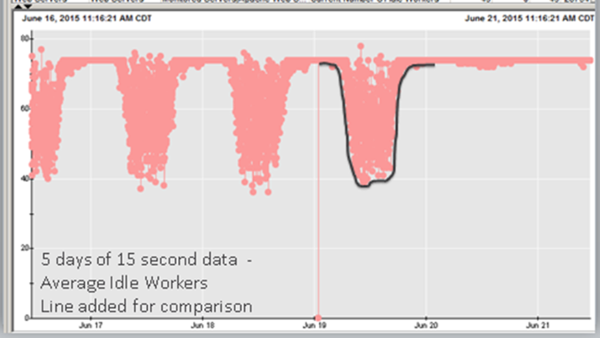
Idle Worker Characteristics
No Activity (Idle workers count is high)
Normal Activity (Idle workers count is lower)
High Activity (Idle workers count is zero, no new work can be processed)
Notes:
The configured worker is in one of two states. Idle Worker or Busy Worker.
When ‘nothing’ is happening on the device, the idle workers are many (up on the chart), however as the system gets busier, the idle workers are doing work, becoming busy workers, so there are fewer available idle workers to do new work (lower on the chart). When idle workers get to zero (bottom of the chart), there are no idle workers to service new work, and you are effectively down, that is, unable to process new work, until workers become idle again. (assuming your application survives the out of resources condition, or is able to gracefully recover)
In our use case, idle workers are independent of all other resources. It matters not one bit that you have extra terabytes of storage, gigs of network, megs of ram and plenty of CPU. When the system as no idle workers to service new work, our application is effectively down.
If average is better as time resolution shrinks, surely average will a suitable on 15 second data.
5 transactions a second * 15 seconds = 75 distinct events summarized to one number
While I agree in theory, in practice you should use other metrics to CONFIRM that average is appropriate, especially when troubleshooting a system.
If I said that the application is having serious trouble starting where the star point is, would you believe me? Would you suspect idle workers? Would you go look elsewhere?

Slide 12

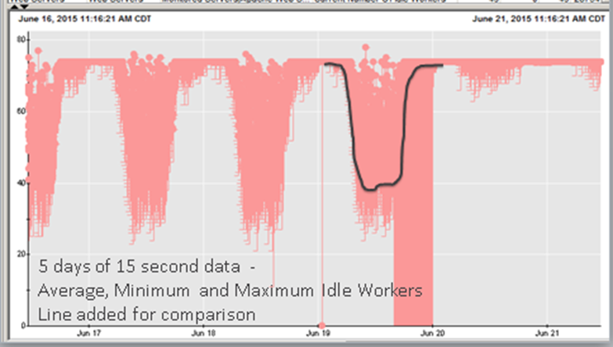
Tales from the Real World: Minimum Idle Workers
Minimum Idle Workers (15 seconds average)
Minimum Idle Workers (15 seconds, minimum)
Notes:
We monitor idle workers that support this super important application.
We research and see this chart (left). This is a perfectly fine looking chart. Basically half of the resource is ‘un used’ as indicated by the white space under the dots. Remember this is a negative chart, meaning up is good and down the chart is bad.
But the chart on the right has minimum turned on. This is much more interesting. Not only do we not have half of our resources unused, but on that one day, we have ZERO resources for HOURS inside 15 second time slices.
This is actionable intelligence
===
In the example, on average these behaved in a completely normal way even when there was a problem. What the technicians did during the troubleshooting was to restart the JVMs, which resolved the problem. The conventional wisdom was that the JVMs are misbehaving in some way that no one could figure out, but once it was found that resetting the JVMs resolved the issues investigation stopped.
When we pursued the minimum idle worker alerts we interrogated the monitoring data and ‘found’ the show minimum and maximum check box in Wily. This revealed the other chart. Once this was observed we told everyone about it and got very hostile responses, from all but one important application owner. They used the data to determine which device was ‘freaking out’ and causing the burst of connections that ‘flooded’ the idle workers but did not get anything done. A code fix or two mitigated the issue and the application went from three a week ‘all hands on deck calls’ about poor performance, to zero ‘all hands’ calls for a year. Simply by having more complete information that pointed them to the real problem.
For the record, the JVMs had nothing to do with the actual problems. They were victims of the upstream device flooding them with bogus connections or the downstream not releasing connections appropriately. Resetting the JVMs forced resets of these bogus connections both upstream and downstream which seemed to clear the problem, at least for the moment. As they were where the corrective action seemed to happened, they were blamed as the problem.

Slide 13
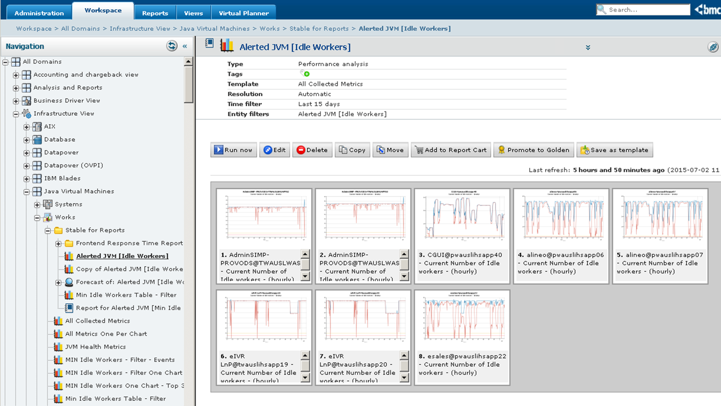
Driving a Cultural Change Away from Average
With AVERAGE (blue line), operations troubleshooting teams used to restart the JVMs. The conventional wisdom was that the JVMs are misbehaving in some way that no one could figure out, but once it was found that resetting the JVMs resolved the issues investigation stopped.
With MINIMUM (red line), operations and developer teams monitored and mitigated the issue. As result, problematic applications went from three incidents per week due to poor performance, to zero incidents calls for a year.
In addition, dedicated reporting and alerting has been created to look at Minimum Idle Worker as a key indicator for Apache Server applications. In this case average is a useless metric even in small time slices.
Notes:
The result of this little find was the application owners and technician now look at minimum idle workers as a leading indicator.
As idle workers gets below some threshold, 10 lets say, they look to see what the environment is doing.
This gives some early warning and lets them know when a problem actually started, not when it was seen by customers. And THIS insight allow for the operations and developer teams to mitigate the issue.
In this case average is a useless metric, even at small time frames, which PROVES (at least in this case) that the road to actionable intelligence was paved with average.
In the top chart, the minimum idle workers repeatedly goes to zero. This application needs attention despite the average ‘hugging’ the top of the chart.
The middle chart shows a recent problem that also has a history in the last two weeks.
The bottom chart shows mostly OK except for three incidents in the last two weeks.
Which one needs the most attention??

Slide 14
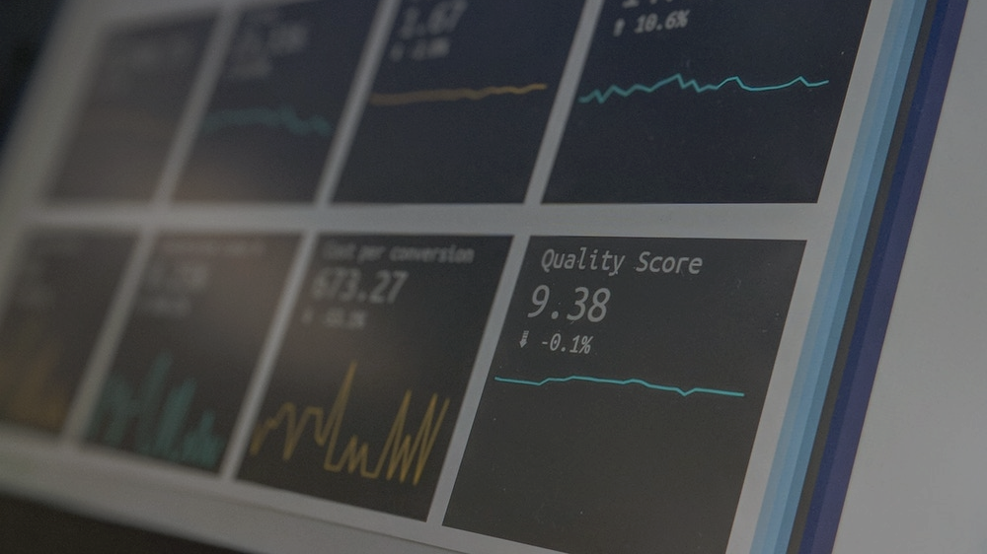
The Secret Sauce
“The analyst’s rule of thumb should be to use the best metric, at the best resolution, of the best statistic”
you will not be able to determine what this is without looking at the options
Notes:
The root failure of the initial analysis is the ‘love of average’.
The application troubleshooter said:
“Average is all we look at. Especially in a 15 second slice, minimum and maximum would be little different. So there is no use to look.”
Rubbish I say.
The analysis rule of thumb should be to use the best metric, at the best resolution, of the best type (min, average, max, etc.).
And you will not be able to determine what this is without looking at the options.

Slide 15

Food for Thought
“Is 86400 events averaged to a single point really the metric you wish to base your career on?”
(*1 second resolution timeseries aggregated to hourly resolution)
Notes:
Is 86 thousand events averaged to a single point really the metric you wish to base your career on?
That is what you get with hourly average of the typical transaction based application

Slide 16
Conclusions
Notes:
What can we conclude from this little story??

Slide 17
3 Key Takeaways
Average, on average, is a below average metric
If you ONLY use the average to find actionable intelligence, you are firmly on the road to (actionable intelligence) hell
The analyst’s rule of thumb should be to use the best metric, at the best resolution, of the best statistic
Notes:
That average, on average, is a below average metric. Especially in troubleshooting.
If you ONLY use the average to find actionable intelligence, you are most certainly on the road to actionable intelligence hell.
However, if you follow the rule of thumb to use the best metric, at the best resolution, which means incorporate other metrics such as minimum, 95th percentile, and maximum, you are on the road to actionable intelligence.
We are not against average, but we, as professional analysts, we should be for finding actionable intelligence, and that is not ONLY done with average.
I submit this is one road we should be on to get there.
Movìri is here to help with these and other tools and techniques. Give us a call.
===
These ideas are used in this presentation
http://mlcu.com/Session533-TSCO-MotherLodeForActionableIntelligenceV03.pptx
http://mlcu.com/articles
http://moviri.com/blog

Slide 18
Q&A

