Slide 1




TrueSight Capacity Optimization
is the Mother Lode for
Actionable Intelligence!
Mr. James Kistler Infrastructure Planning Services Manager
Mr. Ben Davies Senior IT Business Consultant
September 10, 2015
Notes:
https://bmc.g2planet.com/bmcengage2015/public_session_view.php?agenda_session_id=165
Session 533: BMC TrueSight Capacity Optimization is the Mother Lode for Actionable Intelligence
Actionable intelligence is obtained in so many different ways, by so many people, that TrueSight Capacity Optimization becomes a virtual mother lode for it. Join us for real-life examples of how HCSC extracts actionable intelligence from TrueSight Capacity Optimization.
In this session you will get a practical view of the tools and techniques HCSC uses and hear from the practitioners about:
• Analysis of diverse data that is assembled in TrueSight Capacity Optimization
• Chargeback to projects and APM applications
• IT costs vs. IT charges in chargeback models
• Opening TrueSight to 'the masses' and how to conduct just-in-time training for various constituencies that arrive at unpredictable times
• Views customized to application owners and equipment owners, as well as views focusing on opportunity cost
• Analysis used to find over-used equipment (and provide more resources)
• Analysis to root out under-used systems for retirement (the concept of server vs. service is important here).
This is not just theory! Ben Davies and James Kistler will walk through how TrueSight Capacity Optimization, along with clever analysis, redefined a 'well understood' metric, making it into a real-time indicator of actionable intelligence and reports, appropriate for application owners to take action.
James Kistler, Manager, Health Care Service Corporation (HCSC)
James Kistler is an IT leader and expert in IT Planning. He joined Health Care Service Corporation in 2007 and has managed and led multiple IT teams and functions, including resource management, capacity planning, budget management, cost allocation and IT cost transparency. James has a unique background that blends business analytics, strategy and IT management. Today James focuses on optimizing IT processes, and specifically capacity planning, to achieve maximum revenue and support HCSC’s rapid growth. He thrives in fast paced, high-volume environments where priorities compete and change. James holds a Bachelor of Science degree from Indiana University in Bloomington. In his free time, you can find him on his motorcycle in search of blank spaces on the map.
Ben Davies, Senior IT Business Consultant, Health Care Service Corporation (HCSC)
Serving in the US Navy (Submarines) for 9 years and with an eclectic background in food service management, hotel management, IT tech support, documentation, training, IT security, IT audit, and most recently in IT capacity management, Ben brings a unique perspective that is irreverent, insightful, annoying, and sometimes entertaining.

Slide 2
Agenda
1.
HCSC Introduction.
Tools and Techniques in these contexts
-Analysis of diverse data
-Chargeback to projects
- IT Cost VS. IT Charges
- Open ‘to the masses’
- The Power of Views
- Over Used, add resources
- Under Used, remove resources
2
3.
A ‘Well Understood’ metric, JVM Idle Workers
4.
A Call to Action / Questions
Notes:
Good Morning,
This is Mr. James Kistler. A manager at HCSC, Health Care Service Corporation, and Mr. Ben Davies, also from HCSC.
In this session we will quickly introduce ourselves and show how big we are, which is to show that if we can do it, surely, you can do this too. Then suggest that capacity optimization directly supports our Corporate Vision, and show some tools and techniques, specific to BMC TrueSight Capacity Optimization (TSCO).
To be clear about our purpose here today. TSCO can do interesting value add work, but it takes effort and commitment.
If you put data into TSCO you can analyze diverse data.
Then it is a short leap to chargeback and costing.
Then you find that because the data is available, others can easily get value out of the data, which you can enable by opening it to the masses,
and making views.
Views can take a dataset and show over used resources,
then the same data sorted differently can show under used resources.
Finely, we will show that the ‘traditional’ metric of average, is not the only metric that can be analyzed.
We will finish with a call to action, and questions.
Feel free to take our card and contact us. Also, leave your card with requests on the back..
Submit your card with: Presentation, chargeback, or training, on the back
We will forward you any of the documents we discuss here, but they are big. So only request what you will use.

Slide 3


Founded in 1936 and with more than 14.5 million members, HCSC is the largest customer-owned health insurer in the United States and fourth largest overall, operating through its Blue Cross and Blue Shield® Plans in Illinois, Montana, New Mexico, Oklahoma and Texas
We provide health coverage through our Blue Cross and Blue Shield ® Plans, and dental, life and disability insurance through Dearborn National
We are greater than our 21,000+ employees, 60 local offices and state-of-the-art technology, including two Tier IV data centers — the industry's highest reliability level — that provide the speed and data security to meet our customers' current and future business needs
With Administrative services line of business, and being part of the Blue Cross and Blue Shield Association, HCSC has a national footprint
Health Care Service Corporation
Notes:
Health Care Service Corporation, a Mutual Legal Reserve Company, an Independent Licensee of the Blue Cross and Blue Shield Association.
Founded in 1936. With 14.5 million members, 55 billion gross revenue, five Blue Cross and Blue Shield ® state plans (Illinois, Texas, Oklahoma, New Mexico, Montana), multiple subsidiaries and lines of business, 21,000 employees, 60 local offices, and two tier IV (4) data centers, we are big by any definition.
TIME Magazine states we are number 5 in their top 20 privately held companies. (June 2015)
http://time.com/3854318/largest-private-companies-america/
Download this presentation. There are links in the notes section the talks about how architecturally interesting this building is.
===
Data accurate to early 2015.
http://www.hcsc.com/
http://www.hcsc.com/hcsc_hq.html
http://en.wikipedia.org/wiki/Blue_Cross_Blue_Shield_Tower
Received Trustee award for the HCSC Blue Cross Blue Shield of Illinois (BCBSIL) headquarters vertical completion project from the Chicago Architecture Foundation in 2006
http://www.glasssteelandstone.com/PrinterFriendlyBuildingDetail.php?BuildingName=Blue%20Cross-Blue%20Shield%20Of%20Illinois%20Tower&LocationCity=Chicago&LocationState=Illinois&LocationNation=United%20States

Slide 4
Our Vision
Our Purpose
“To do everything in our power to Stand with our Members in sickness and health.”
Drive competitive advantage via efficiencies and cost-effectiveness through IT optimization, simplification, and agile infrastructure & applications
Notes:
We are using BMC TrueSight Capacity Optimization and other BMC tools to directly support our Corporate Purpose and Vision.
This is a shameless plug, but, HCSC is a good company, that tries to be a good company.
However, good software and good intentions are not enough. Effort must be exerted to apply the good software to achieve a goal. This effort is substantial, but effort is required. There is actionable intelligence to be gained, if you apply these tools and techniques presented in this session, and actually put them to use.
==

Slide 5

Data As A Corporate Asset
Data is a Corporate asset, and needs to be made available to all legitimate uses.
The key for this audience is:
facilitate liberating this data.
The value proposition is that when your data is in TSCO.
Applying TSCO tools and techniques, enables you to extract substantial additional value from the data.
Having senior support is VERY helpful in getting diverse data.
Notes:
For TSCO to be most valuable, a host of data sources need to be queried. Don’t take everything, only what is likely useful, but also don’t allow anyone to say they won’t give you ‘their’ data. Data is a Corporate asset, and needs to be made available to all legitimate uses.
There were occasions where we used the ‘Corporate asset’ argument, which went basically like this:
“We are on a mission from the Office of the CIO, and he needs this data for analysis, please call the CIO and explain to him why he can not have ‘your data’. “
Not subtle, but the CIO was actively breaking down silos, so everyone knew this was not a conversation they could win.
Your mileage may vary.
The key for this audience is: Facilitate liberating this data to a place where it can yield actionable intelligence. Applying TSCO tools and techniques, is the enabler that allows you to extract substantial additional value from your already existing data.
We will see in our examples how this additional value, essentially free value, is enabled by TSCO.
Having senior support is VERY helpful in getting helpful data.

Slide 6
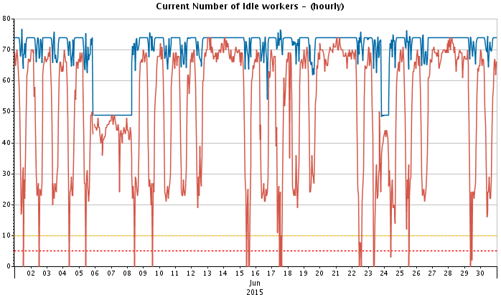
Analysis of Diverse Data
Access to the data is only part of the issue. Understanding the data is arguably the most important aspect.
Analysis of diverse data becomes difficult.
The data input map should have well understood metrics.
Notes:
Access to data is only part of the issue. You also need to understand the data in the context of where and how it was collected.
As you gather diverse data you will find that not everything is percentages. Even when metrics are counts, how do you compare employee count with pages printed counts in a meaningful way? How do you compare VPN connection counts with the weather? What would that comparison mean?
Understanding the data, is arguably the most important aspect of having the data. Many times there is not direct metric to the most meaningful data. Surrogates need to be found, and understanding is the key to finding and using surrogates successfully.
Your data input map should have a lot of connections with well understood metrics. As we will see, not all metrics are as well understood as you might think.

Slide 7



























The Mother Lode for Actionable Intelligence
Performance Insight
Web Trends
 | Network |  |  | Servers
 | BAM RSC / Portal
 | Public Site Hits / Visits
Databases
 | RSC Hits / Visits
 | Producer Portal Hits / Visits
Quest Performance Analysis
 | RSC Business Drivers
MONITORING TOOLS
SQL
DB2
Oracle
(IBI,ICI, IMI,IPI)
Workers: Public Site, Legacy, RSC
NPI Crosswalk Service Call Counts
NetQoS Internet Circuit Utilization
BUSINESS DRIVERS
BMC Atrium CMDB
V Center
CVP Call Voice Platform
eIVR –
Ingress
Gateway
Edgesite VDI Counts
BMC TrueSight CAPACITY OPTIMIZATION
Cacti
VPN counts
Member Liability Estimation
Edgesite
AP WEB
Counts
CMM
NMON
Aceyus
CVP counts
Real Time Adjudication Counts
NetQos Application Bandwidth
DynaTrace
NetQoS
Cisco Prime Wifi Network
Sentinel
83X
Transactions
Real Time Benefits Transactions
Personnel
Counts
CA Wily
Tivoli Productivity Center (TPC)
Webex Ports
Utilization
RTIS
Mainframe Transactions
BMM
Cisco Prime
ODS
DMIH
Online Sales Channel
Notes:
TrueSight Capacity Optimization connects to many different data sources for device monitoring metrics, middleware metrics and business metrics. Gathering the data and making it available in one place allows for analysis on many different metrics and metric combinations.
If the number of ETLs is a measure of the effectiveness, then it looks like we have won. However, the real measure is the amount of actionable intelligence that is produced, not just by the capacity team but by anyone.
The Mother Lode of actionable intelligence is, leveraging the data needed to do effective capacity optimization, and turning that into value add for other purposes.
The chart is too small to read, sorry. But contains: Performance Insight, Quest, BMC Atrium CMDB, Vcenter, DynaTrace, NetQoS, FogLight, and even NMON.
Business metrics include: Public site hits, internal site hits, circuit utilization, voice call counts, adjudication counts, submission counts, people counts, sales counts, sub transaction counts, and even the weather.
There are ‘hidden slides’ that discuss the data map. And give examples: one for using weather data, and one for monitoring for policy compliance. The example is monitoring proper RAM and swap utilization, which for the record, is not using the RAM utilization metric.

Slide 8
Know Your Data Map, Understand The Data, Extract Actionable Intelligence From The Data
Data can come into TSCO from a number of different sources, providing a singular repository to pull actionable intelligence from.
Talk to your app owners, find out what metrics they use for their analysis, It is likely useful for capacity, trending, and anomaly detection.
Know your data map and UNDERSTAND the metrics. Each metric should have at least one study, chart or forecast where it is used.
Review policy statement for configurations, maximum utilizations, minimum utilizations, performance guarantees, key indicators and other metrics. Then use BCO to monitor compliance with policies. Most of these metrics are also useful for trending, performance monitoring, capacity, and anomaly detection. Placing them in one place, such as TSCO makes them useable in other analysis where these metrics become proxies for metrics not available.

Slide 9
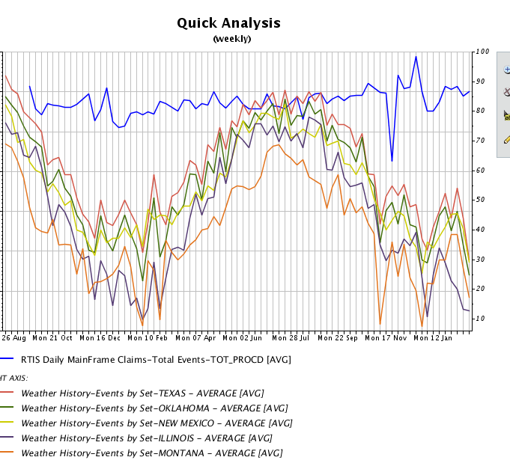
Claims Submitted VS. The Weather
Notes:
TSCO will allow you to compare any number of metrics. We have compared insurance claims against the weather, with the thesis of good and bad weather increases the rate at which claims are submitted. Assuming that when the weather was nice people would be out more, and get hurt more. When the weather was bad, people would be skiing (and other winter sports) and get hurt more. We found that people file claims independent of the weather. OR that the process of submitting claims mutes any fluctuation that would have indicated a connection to weather. OR that the metric of average temperature is a poor proxy for the weather that would drive behavior that would result in more or less claims being filed.
In the chart, there is a slight increase in the number of claims submitted over the time of the chart. This is driven by acquiring more members, the fluctuation in the claims line is within the ‘voice of the process’, except the Nov and Dec variations which are driven by external forces, not the weather.
The determination made is that, even with the limits of these metrics, claims are submitted in a regular cadence, so even if the weather is a meaningful component, there are likely other components that impact the claims submission rate as well. Therefore, such a simple comparison (average temperature vs claim submission rates) is not sufficient to determine the impact of weather on claim submission rate.
http://www.isixsigma.com/dictionary/voice-of-the-process-vop/
How you use that data is up to you. Play around with the tools you have, make mistakes and learn from them. Analysis isn’t black and white, make sure you are looking at the problem from all angles.

Slide 10
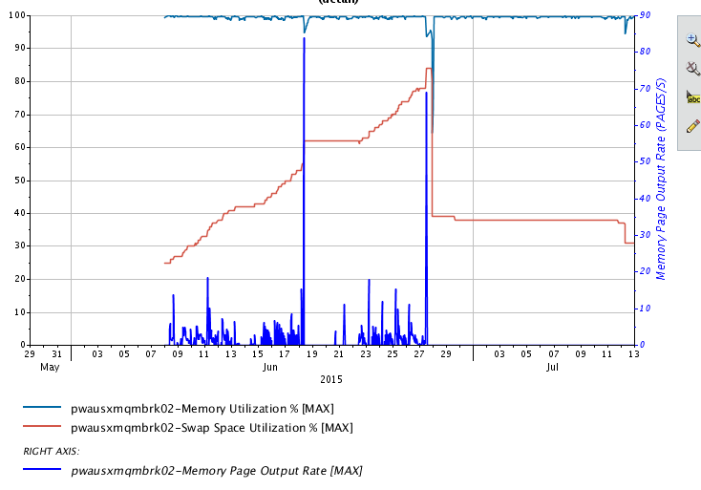
Memory, Swap + Page Rate
Notes:
This memory analysis is used to determine the ‘appropriateness of memory and swap space size’
While average has no meaningful impact on memory size or swap space, average swap rate ruins this analysis. Which is one of the reasons it took us so long to come up with this analysis. However, by using maximum on the metrics, we find a useful way to evaluate the appropriateness of a given devices memory, and swap, configuration.
In a perfect world you would see memory at near 100%, AND swap used >0 but not exceeding ~45% and reasonably stable, WITH some swap rate. This would indicate that there was enough RAM for operations, but not too much. Swap was large enough to accommodate normal operations with enough space for a surge without ‘crashing’ the device, AND that the swap was just needed to accommodate normal operations. June 8th to June 18th but with a flatter swap line.
In this case a process seemed to be ‘eating swap’ and the device rebooted on the 28th, which resolved the issue ‘for now’. After the reboot the analysis would suggest that there is too much RAM, despite swap being used, as there is no swap page rate. In reality the cost in manpower and down time needed to adjust all devices to optimal RAM size is not offset by the savings in liberating the RAM (a relatively cheep resource).
However, a real world use of this analysis is making a similar device. Use this analysis to originally ‘right size’ RAM and swap.
This analysis goes against the school of thought that ‘any swapping is bad swapping’. Our suggestion is that there is such a thing as too much RAM, and the measure of that is to shrink RAM to the point that swap is used but not significantly. I recommend a configuration policy that states “RAM is to be configured such that swap space becomes used, and maximum page rates are greater than 2 pages/s (max), over a duration of an hour; and less than 500 pages/s (max) over a duration of an hour” In addition swap policy that states “Swap shall be two times installed RAM but not used above 50%” The remaining space is large enough for core dumps
This policy is monitor able by swap space utilization. Zero is non compliant >50% is non compliant

Slide 11

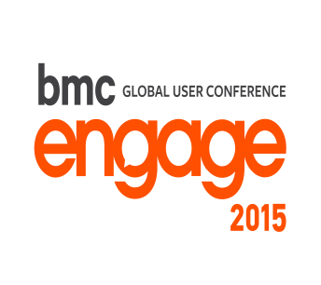
Charge Back
To the extent the data is ‘universally’ available, then you can do interesting things with it. Including charge back to applications and projects.
Importance of chargeback – it is not finance, it is to modify behavior
A useful, consistent, lie
This effort brings consistency, transparency and understanding
Notes:
TSCO gathers configuration data from the Configuration Team (Atrium and CMDB), also utilization metrics from monitoring tools, association tables from application management teams, ‘price lists’ from accounting, and other data.
To the extent that the data is ‘universally’ available, you can do interesting things with it, including charge back, show back, shame back, whatever is appropriate in your environment.
The importance of charge back is nothing to do with finance, and everything to do with modifying behavior. The behavior changes are to save blue money, internal money you can control, but the long term goal is to save green money, actual cash out the door.
http://www.isixsigma.com/topic/blue-money/
You will find that your ‘costs’ are complicated, and there will never be agreement that any answer you arrive at will be ‘correct’. We have found it helpful to strive for a useful, consistent lie. The answer is not ‘THE ANSWER’ but was figured in a way that is understood and allows for comparison within the system.
Said a different way, this effort brings consistency, transparency, and understanding about how much something costs vs. another thing. This allows for decisions to be informed in a consistent way on cost, then compared against the perceived or measured value that something returns back.
Think “useful consistent lie”. The ‘truth’ is an expensive illusion.
The value proposition is: by assembling existing data in TSCO, and adding some organization, you get the ability to relatively easily make a chargeback model, with the goal to modify behavior

Slide 12
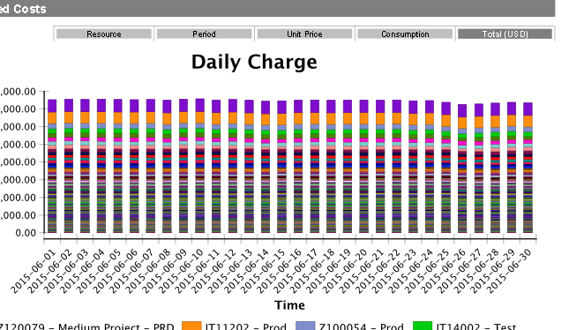
Chargeback To Change Behavior
A sample report that shows the resources associated to all projects. This sort of report encourages tracking the total and comparing your project to the total and to other projects.
Other reports allow for reporting the efficiency of the resource use and allows the ability to ‘right size’

Slide 13
The Useful, Consistent Lie
You cant handle the truth.
Useful consistent lies are everywhere, mostly because they are, well, useful. The truth is an expensive illusion.
Notes:
Cost transparency should result in actionable intelligence. That is to say, DRIVE BEHAVIOR. – Actionable intelligence should result in ACTION, which includes willful inaction.
Cost transparency is an iterative process. – After each round there will be ‘better’ metrics to trigger a charge. Only allow this to the extent that it is useful. Good enough is, good enough. Remember, this is a useful, consistent lie. Perfect is an expensive illusion.
The biggest threats are political, cultural, and inertia. Way down the list are data availability, technology, and implementation difficulty.
It helps to abandon the goal of ‘truth’. There is very little truth in real life, only useful, consistent, lies. For example, what time is it (right now). My clock said 2:33 but that is a lie. It is actually 07:33:47.987345 per US Naval Observatory Master Clock UTC… or 14:33 Central Time (24 hour clock). Even if you chose a time lie, you are then faced the definition of the sentence. Is ‘right now’ when we started or finished the question? Or the time the question was received by the noun expected to answer? Or did they fudge and adjust the answer to coincide to when we were expected to get the answer? The closer you look, the fewer use cases actually depend on the nuance of the ‘truthful’ answer. So in the cost transparency model of TrueSight Capacity Optimization how much something costs has a string of qualifiers attached and should be regarded as a useful, consistent, lie.
http://tycho.usno.navy.mil/cgi-bin/timer.pl
Not compelling enough. Where are you, right now, cosmically. Anything less that GPS in 3 dimensions, to 64 decimal points, is not ‘truth’. But now you have to define what point constitutes ‘you’, and have a cosmic frame of reference. When you figure it our, convey that, and have it understood, you are no longer there. Truth.
What is your name. I am Ben Honey Dad to my girl. But Uncle Sam thinks something different and my Navy Drill Instructor had something completely different in mind, I still can not fathom.
How old are you, exactly. Now you have to define a host of parameters, some legal, some religious, for the answer to have any meaning or it is not the ‘truth’. For the record I am 29 again (21st anniversary), 283 days, 17 hours, 3 minutes, 25 seconds from the date recorded on by birth certificate, which has a whole host of assumptions attached to it. Feel better about the truth. My 29th birthday needs a drink.
Useful consistent lies are everywhere, mostly because they are, well, useful. The truth is an expensive illusion.
Costs will create a HUGE issue. We could discuss this for hours but, in keeping with the useful consistent lie, think of it this way: What is you cost transparency recovery target? Then as a completely separate thought you able to account for in cost transparency system. That is the items you are charging for and how many of them can you ‘sell’. Then do the math (simple division).
I need to recover 100,000 dollars a year. I can account for 100 named servers, in each of the 12 months. That makes 100,000 dollars divided among 1,200 machine months. That makes each one cost $83.33 a month. Target Return Pricing.
This conversation does not concern itself with how much a named server actually costs to produce, only how much do to recover, and how many things can be used to recover that much. This is foreign to us, as it is a business type conversation and not a technical conversation, that is partly why the conversation feels, unfair or dirty to technical people.
http://www.businessdictionary.com/definition/target-return-pricing.html
Emotion is a fearsome opponent of logic and reason and facts.

Slide 14
IT Cost vs. IT Charges
There is a disconnect among IT professionals between IT Cost and IT Charges used in charge back.
It can be a tough distinction to make, some will need your help understanding IT Cost vs. IT Charges.
A report like this helps visualize overall cost and to compare projects.
Notes:
Based on our conversations for charge back, we see that there is a disconnect among IT professionals between IT Cost, and IT Charges, used in charge back.
It can be a tough distinction to make, some will need your help understanding IT Cost vs. IT Charges.
The value of a report like this is that it helps change behavior. This is of all projects, and it is obvious which ones are the most expensive regardless to the understanding of cost vs. charges. Combined with pressure to minimize cost, there are visible, tangible, indicators of progress, or not. This influences behavior to hopefully reduce a projects relative cost, and therefore total cost.

Slide 15
IT Cost Vs. IT Charges Example
IT Cost (Average) |  | IT Charge
Basic server, CPU, Memory | $7,000 USD | $27,000 USD
OS, Monitoring SW, Management SW, vendor support, etc.. | $4,500 USD
Operations people , support equipment, and support SW | $3,400 USD
Power, cooling, floor space, security, network | $1,200 USD
Specialty SW like DB, JVM, WAS, etc.. | $4,600 USD
Storage, RAID, mirror, backup, etc. | $6,300 USD
Notes:
Some are surprised that the charge is sometimes several times more than what they consider the cost of the item. We charge $27,000 for a server, and all the ‘stuff’ that goes with it; they think in terms of the $7,000 physical server and think we are doing it wrong. “our servers don’t cost that much’ The customers have the same misconception. “I can go to Best Buy and get a terabyte of storage for 100 bucks.” they say, however, they failed to account for RAID, backup, mirroring, DR, software and the people to make it work.
On the left are the items needed to deliver a server to a customer. On the right, is the price presented for the server.
The component pieces have components of their own, so getting the ‘truth’ for a cost approaches impossible and is not helpful. Charges are informed by actual costs but are completely different things. To influence behavior, you may wish to ‘over charge’ for obsolete technology, while subsidizing newer technology, as an attempt to change behavior. Specifically, to move customers away from one technology choice, and towards another technology choice.
Value Statement - TSCO allows for this conversation to happen in a way where you can model different results.
There are hidden slides that discuss the disruption of these conversations. It contains a brilliant quote, by Mr. Ben of course, “The status quo is emotionally involved so immune to logic, and reason, and facts.”
==============
Chargeback forces this conversation, which turns out to be exceptionally uncomfortable for technologists new to the financial conversation. I find that the best technologist are the worst at this conversation. They are too smart. They KNOW what a server costs and that two servers bought at the same time can have vastly different costs (due to configuration), so they have trouble accepting a ‘single charge’ number for a server. They let what they know to be true about cost, get in the way of having a useful conversation about what to charge. The attention to detail, and literal thinking, that makes them good technologists, make they horrible at costing and charging.
It takes the concept of a ‘useful consistent lie’, in whatever form you are comfortable with, along with strong leadership to make this work.

Slide 16
The Cost VS. Charge is DISRUPTIVE
Not only is there difficulty in understanding the cost vs. charge. But the whole conversation is disruptive. Technologies are now considering new things (cost and charges) that are not completely understood in their decisions and are not comfortable about it.
Their customers are also faced with a disruption to the status quo. They like it less.
Pricing is easy minus the politics. Arriving at the what to charge can be political so can create problems.
The status quo is emotionally involved so immune to logic and reason and facts.
Notes:
If all of the elements are in place and you decide to undertake cost transparency, you stand to gain huge benefits beyond simple cost transparency. The act of charging based on consumption is disruptive to the entire decision making eco system. There will be unintended consequences, including overtly bad ones, but there will also be unintended consequence's that are overtly positive, and not easily relatable directly to cost transparency.
As the disruption is anticipated, or starts to actually happen, people that may have supported you, may now be threatened. The status quo hates you. Be diligent. You will find cost transparency to be an agent of change that is trophic cascade of change.
http://blog.ted.com/2014/02/18/video-how-wolves-can-alter-the-course-of-rivers/
George Monbiot poetically explains how reintroducing wolves to Yellowstone National Park after a 70-year absence set off a “trophic cascade” that altered the movement of deer, sent trees soaring to new heights, attracted scores of new animals to the area (think: beavers, rabbits, bears, bald eagles and more), and stabilized the banks of rivers making them less susceptible to erosion.
However, you will find that questions that could not be answered in the past are now answerable. The old application costs 50,000 a month in old hardware support costs but only brings in 400,000 a year in revenue. To the good corporate citizens, you are now a hero, to the status quo of the application, you are a mortal enemy.
You will be able to show that the policy that said every ‘critical application’ must have 100% duplicate systems in DR, can now be shown to have a significant cost. Good corporate citizens tend to make better corporate decisions when complete information is available. Now with the perceived value of the rule, someone can enforce that rule with a more complete picture of the actual cost, and perceived cost, vs the actual benefit, and perceived benefit.
===
Nay, the English spelling of Danish nej "no". There are people that will say “no” to anything new. This is especially true with a disruptive new technology. A nay sayer in a position of authority can be detrimental to the cost transparency effort directly, or impede one of the critical components. Don’t take a ‘no’ from anyone that cannot tell you yes, insist they pass it to higher authority.
FUD Dragons, a Benism (made up word by Mr. Ben). Intended to represent the people that use FUD.
http://en.wikipedia.org/wiki/Fear,_uncertainty_and_doubt
“FUD is generally a strategic attempt to influence perception by disseminating negative and dubious or false information.”
The people that use FUD wish you to imagine a dangerous dragon where there is none. Most times there are no facts supporting FUD Dragons, and the people that create FUD generally turn out to be punks and bullies that cannot stand a fact based conversation. Occasionally, however they can out maneuver you, and take your lunch money. Slay these FUD Dragons as quickly as possible, as the perception of reality becomes reality, even when based in FUD.
Inattention, a cousin of sloth, one of the seven deadly sins, which can kill your efforts.
Inattention or poorly handling the politics can kill the effort, or burden it under bureaucratic or procedural load sufficient to collapse the effort. Cost transparency is an active enemy of the status quo, and will find enemies, literally everywhere. (see FUD Dragons)
You can derail yourself with lack of preparation or thinking the cost transparency will eventually run itself. cost transparency is hard, disruptive, sensitive, and in constant need of diligence.
Illusory superiority in you and others will feed the enemies of cost transparency, and cause you to underestimate the difficulty, or the motivation of foes, and overestimate your abilities. Accept that you are guilty of this, and take care to minimize the effect by being aware that it is present.
http://en.wikipedia.org/wiki/Illusory_superiority
Illusory superiority is a cognitive bias that causes people to overestimate their positive qualities and abilities and to underestimate their negative qualities, relative to others. This is evident in a variety of areas including intelligence, performance on tasks or tests, and the possession of desirable characteristics or personality traits
Do not let cost transparency become the place to do DETAILED billing accounting. Remember the useful, consistent lie. Let cost transparency figure the bill based on facts in evidence, then handle exceptions in the follow on process, and definitely do not try to account for exceptional exceptions. Simple, clean, understandable, cost transparency.

Slide 17

Open TSCO
‘to the masses’
We allow ‘everyone’ read access, and encourage them to use their data for their own purposes.
Create short, focused, training collateral.
Encourage your entire work force to use TSCO for their purposes.
THIS IS FREE VALUE.
Submit your card with: Presentation, chargeback, or training, on the back
Notes:
Open TSCO to the masses
This is an excellent way to gain ‘free value’ from the TSCO tool and your data. We have found that the team that ‘owns’ the data, uses TSCO to make some of the reports they were making ‘by hand’. They would query the same data source TSCO does, for the same metrics, then make a graph or chart used in a weekly or monthly report. By letting them leverage TSCO they can get a ready made chart, and it is up to date every day.
This is free value.
We do this by making short, limited focus, PDF based training modules that help users with narrow, specific topics. Starting with dealing with an alert (and walking through logging in to the system), then reporting on an application, and reporting on business metrics, we provide enough to get started. For more advanced analysis, we do this in live training where we ‘custom make’ a set of reports, and encourage them to edit from there. Several groups have gone on to be completely independent, doing their own training, to their own people, and making their own reports.
Value statement – Allowing other groups access to TSCO allows them to gain value as well. This is FREE VALUE.
We have our training PDFs available if you wish. Leave your card asking for the training.

Slide 18
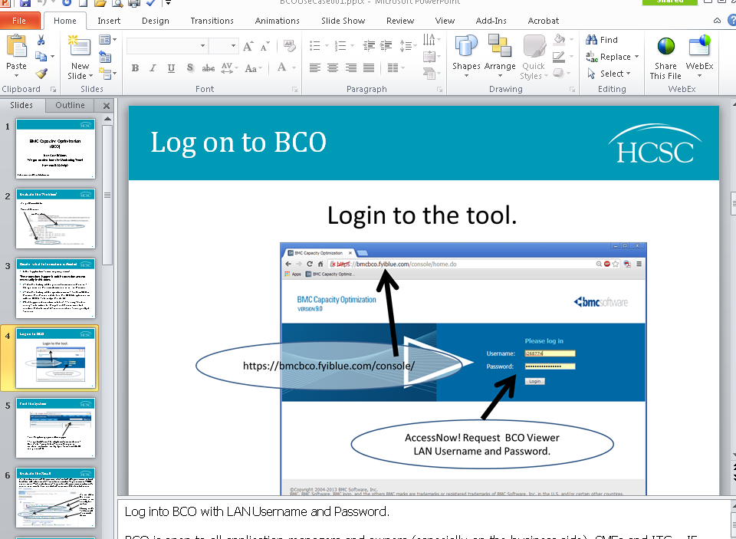
Keeping it Short and Sweet
Notes:
Training sessions and material should be focused and purposeful when it comes to TSCO.
Limit the focus of the individual training documents. Enough to complete a single focused mission.
Use live training to combine these single focused missions into a more complete analysis. We have experimented with recorded WebEx training but find the space it takes, in terms of storage and time to consume to be more that it was worth. The PDF and live sessions seems to strike a suitable balance between all of the competing forces while delivering on providing useful access to the TSCO tool.

Slide 19
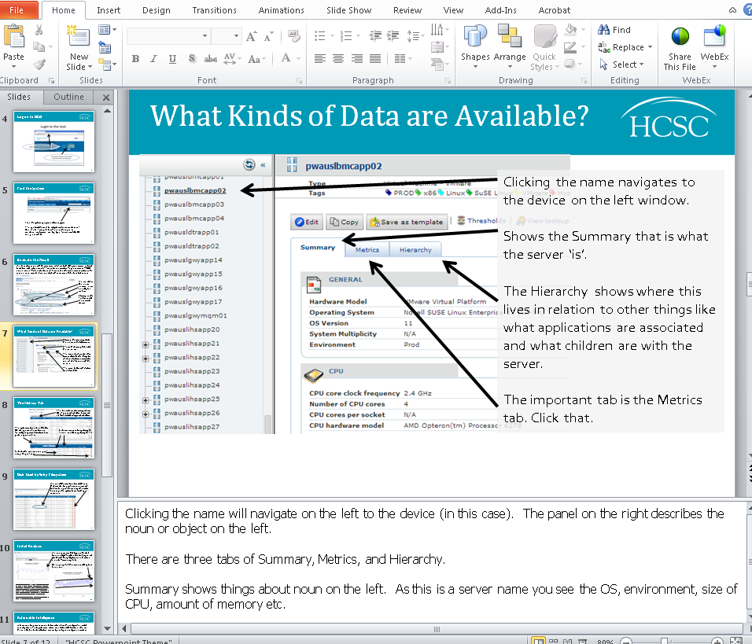
Open Door Policy to Training
Notes:
Your TSCO admins and capacity teams are the source of knowledge when it comes to using TSCO to it’s full potential. Be available to help users with questions and requests. Don’t be afraid to say “Let’s go see if we can”, Understanding effective use of TSCO doesn’t happen in a day.

Slide 20
Limits and Permissions – Get Help
Our original security design was to open TSCO to everyone read only. Then have the ability to make and edit reports.
Then have the ability to do the administrative tasks.
This works reasonably well and we wanted to tell those to ‘set my data aside, so no one else can see it’ was met with ‘our security design does not support that’.
We could have done this with more granularity and we see our permissions design to be the weakest set of decisions we made with TSCO, but have not felt the need to spent any time or effort to ‘fix it’.
When we readdress this, we will do it with the help of a consultant.

Slide 21
The Power of Views
Views are an efficient way to find actionable intelligence
Views are a very flexible way to present data, organized and analyzed into intelligence, then turned in action
Action may be purposeful inaction
Submit your card with: Presentation, chargeback, or training on the back
Notes:
So now we come to views. The Power of Views
Value Statement – Views are an efficient way to find actionable intelligence.
There are a number of ways to present data: reports, studies, charts, tables etc.. Views allows for displaying data in some context, turning data into information. That information can be analyzed, and made into intelligence. Action can be taken on that intelligence. That action may be purposeful inaction.

Slide 22
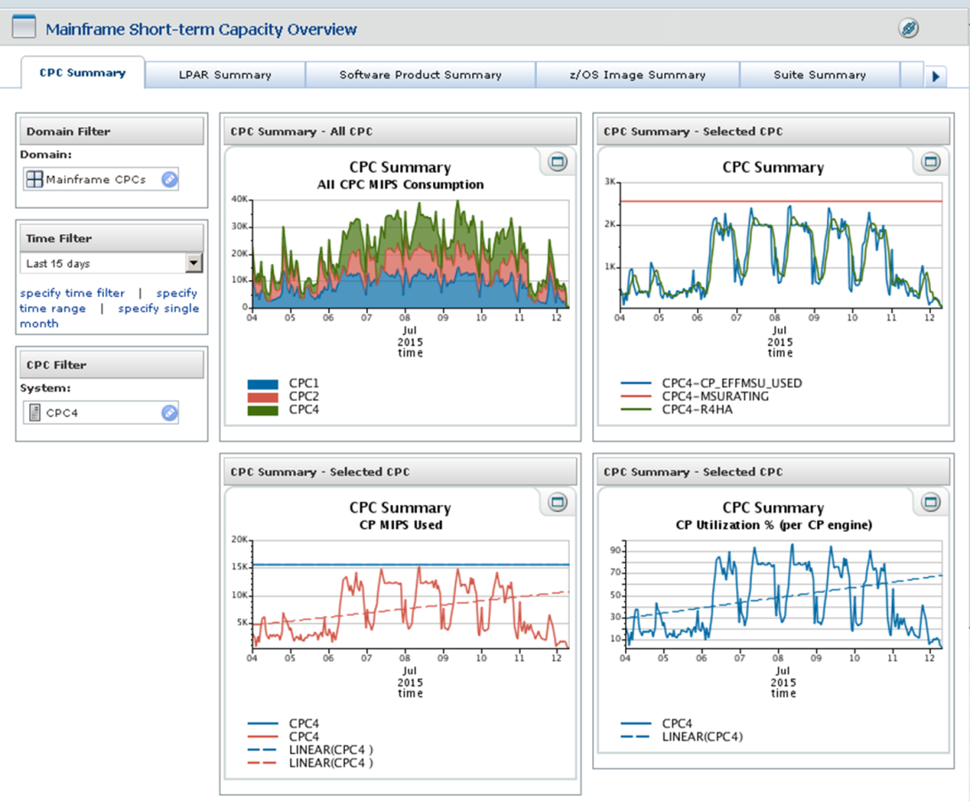
A View For Each Purpose
Focused views for individual lines of inquiry, means that routine answers are addressed quickly.
View for overused devices.
View for underused devices.
View for environments.
View for business metrics.
View for whatever you find routinely interesting.
Notes:
You can have a different view for each purpose.
Views can have drill down ability. In fact we have a view where all applications have an overall metric on the first page. Click the application and the most recent metrics from each machine is shown. Click the device and the history of that devices metrics are shown. View with overall list, to problem application, to problem device, in three clicks.
A view with similar function but with different metrics allows a large data set to be sliced and diced in a number of ways, each with a specific use case in mind.
Value statement -
Focused views for individual lines of inquiry, means that routine answers are addressed quickly, and the same data can be presented in specific, customizable ways. One view for over used devices. One view for under used devices. One view for environments. One view for business metrics. One view for costs. One view for whatever you find routinely interesting.
Download the presentation, there are ‘hidden’ slides that expand on these ideas.

Slide 23
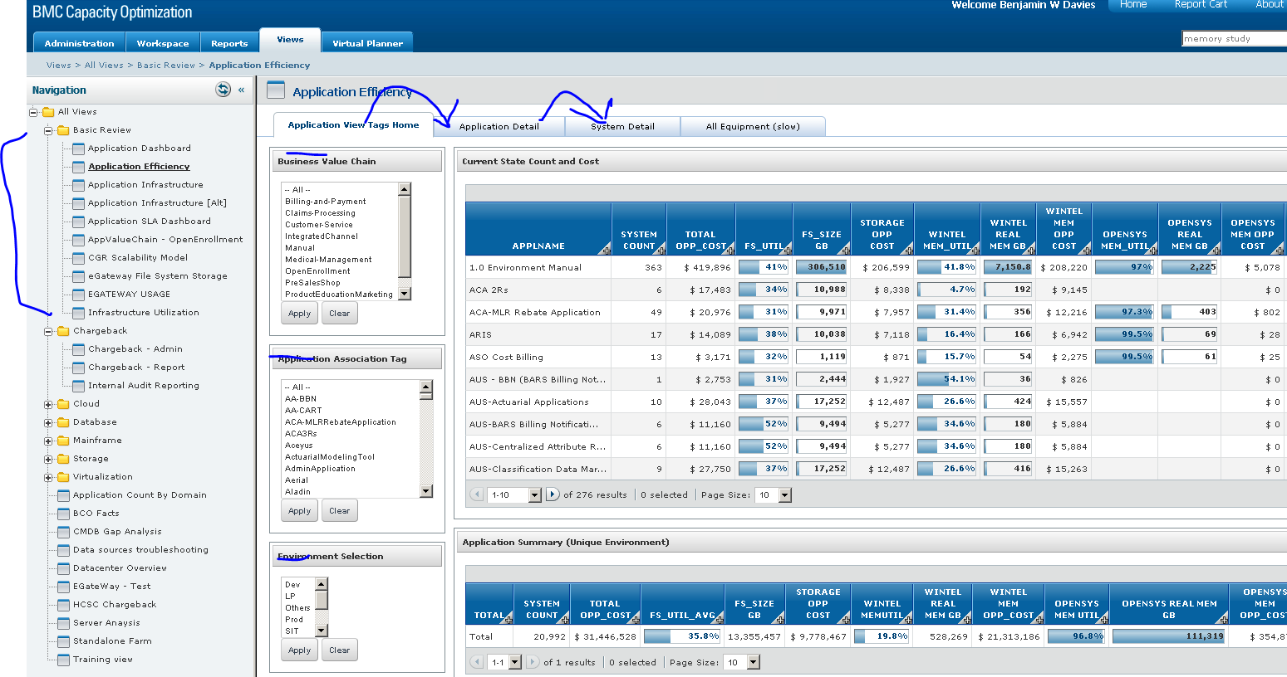
The View Looks Different from over Here
Notes:
Views are your window to your data. They are used to shape how you see the data, and allow analysts to sift through till they find what information they need.
The filters and selection criteria in TSCO for views is extensive. Keep the filters easy to use but relevant. In the example there are a number of filters (second column) that determines which applications are shown (big block on the right). The application name can be clicked bringing up detailed data for each device associated with the application (the second tab). Then the device can be clicked, bringing up detailed metric history for that device (the third tab).

Slide 24

Notes:
The first example showed a table with bars to show relative size of a metric to the rest of the page.
This example is area and line charts, but dot plots, heat maps, stacked area, and other charts can be displayed. A well thought out layout can quickly revel anomalies, out of range metrics and other points of interest.

Slide 25
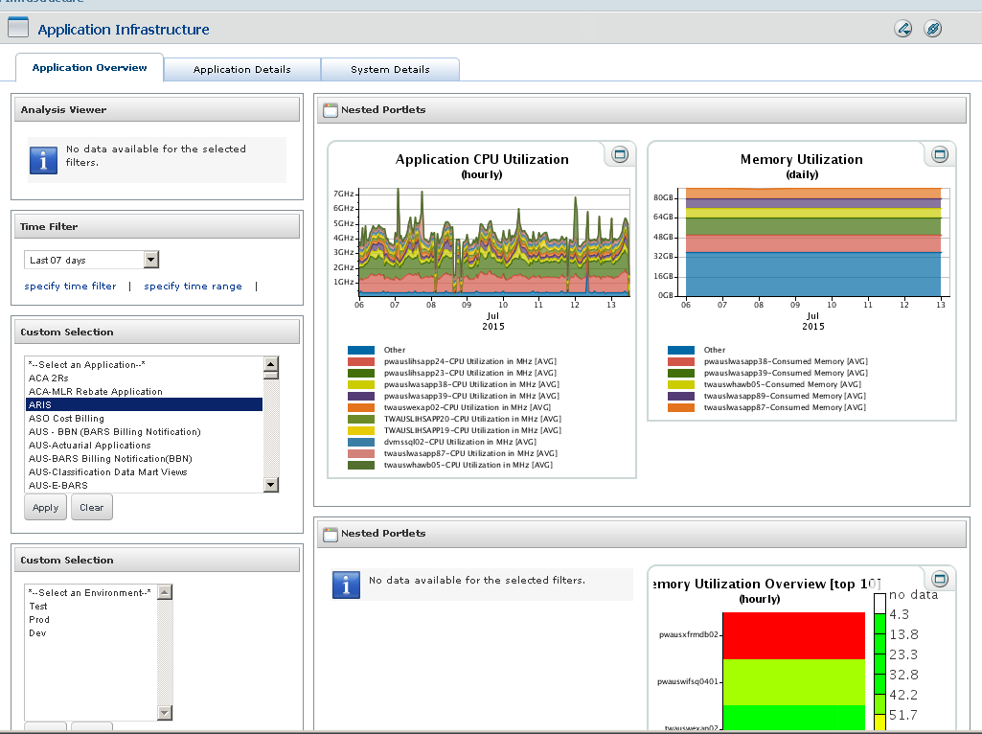
Notes:
Another example

Slide 26
Over Used - Add Resources
One of the first orders of business is to find over utilized devices and ‘right size them’ – This is actionable intelligence
Over used resources may not overtly impede the user experience. However, identifying these early and correcting them helps avoid failures.
More importantly it goes a long way to building trust, when you take the next step of reclaiming under used resources.
Notes:
Value Statement - Finding and correcting over utilization conditions is actionable intelligence from TSCO at its best. CPU may be a little high, but when combined with Run Queue, response time, and other metrics, points to bigger issue than ‘a little high’.
This strain on the system can be the cause of processing delays and faults, so one of the first orders of business, is to find these devices and ‘right size them’. However, Over used resources may go un noticed as they are not perceived as overtly impeding the user experience, but finding and correcting this goes a long way to avoiding failures.
More importantly this effort goes a long way to building trust when you take the next step of reclaiming under used resources.
Download the presentation, there are ‘hidden’ slides that expand on these ideas.

Slide 27
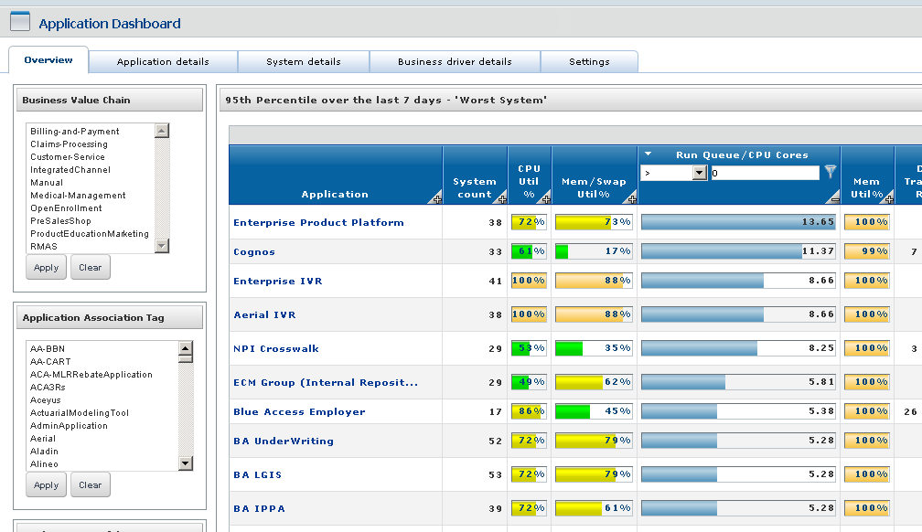
A View To Find Over Used Devices
Notes:
This view shows data sorted by Run Queue Per CPU Core. The top of the list have the highest run queue. Finding and resolving the bottle neck on these devices will, by definition, make the application run ‘faster’.
This same data filtered and sorted different can show highest used CPU, Memory, Storage, Swap etc..
Business metrics or any other metric can be included. So highest print count, longest wait state, slowest response time etc. can all point to resource constraints.
Each of these observations are ‘actionable intelligence’ that is difficult to gain with the monitoring tools where the data in TSCO comes from. The Value add of TSCO is that it finds the anomalies that can be further investigated in the monitoring tools. This actionable intelligence is easy to do in TSCO, and exceeding difficult to do in the monitoring tool themselves (generally).

Slide 28
Under Used - Remove Resources
Under utilized devices can be much more expensive in that they have a significant opportunity costs.
There is a difference between servers (the equipment) and services (the value add) that live on the server. Separate the servers from the services, and liberate the resources to provide value elsewhere.
100% utilization is NOT a useful goal.
Notes:
Value Statement - Finding and correcting UNDER utilized conditions is actionable intelligence from TSCO at its very best. The server may be under used, but the service is critical. Moving that service to another server, which is modeled with TSCO and what if scenarios, saves time and money. In the case of licensing, maintenance and power, this can be green dollars savings.
Paying for a device that should be removed, in time, effort, licensing etc., has significant opportunity cost. Opportunity cost is the hidden cost of not being able to do something of value, because the resource is tied up. Liberating these resources frees the resource to do some other potentially valuable work.
There is a difference between servers (the equipment) and services (the value add) that live on the server. When approaching the ‘owner’ asking if they need the server will be met with ‘yes’ every time, but they are really answering the question of ‘do you need the service that is running on that server’. Separate the service from the server in the question, and liberate these resources to provide value elsewhere.
Effective utilization is NOT 100%. Complete utilization is not possible, and if that goal were to be pursued, would cause more trouble than it is worth.

Slide 29
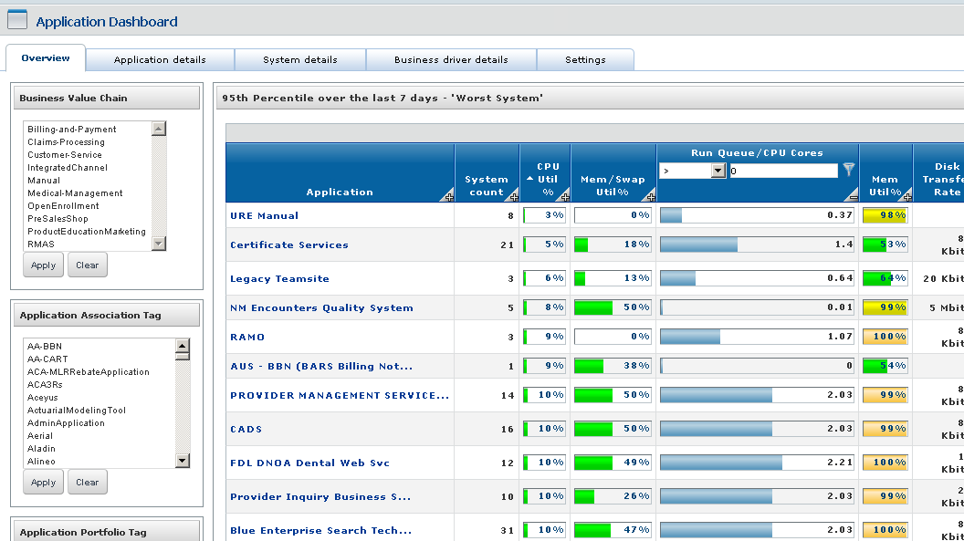
A View to Find Under Used Devices
Notes:
This view shows data sorted by CPU Utilization. The top of the list have the lowest CPU utilization.
This same data filtered and sorted different can show lowest used Run Queue, Memory, Storage, Swap etc..
Business metrics or any other metric can be included. So lowest print count, shortest wait state, fastest response time etc. can all point to resource over allocations.
Each of these observations are ‘actionable intelligence’ that is difficult to gain with the monitoring tools where the data in TSCO comes from. The Value add of TSCO is that it finds the anomalies that can be further investigated in the monitoring tools. This actionable intelligence is easy to do in TSCO, and exceeding difficult to do in the monitoring tool themselves (generally).
Proper utilization varies by metric and situation, but 100% utilization should NOT be the goal.
Queuing theory, the 80/20 rule, and return on investment concepts help inform when to stop trying to recover resource. At least for a while.
https://www0.gsb.columbia.edu/mygsb/faculty/research/pubfiles/5474/queueing%20theory%20and%20modeling.pdf
https://en.wikipedia.org/wiki/Queueing_theory
https://en.wikipedia.org/wiki/Pareto_principle
https://en.wikipedia.org/wiki/Return_on_investment

Slide 30

A ‘Well Understood Metric’
JVM Idle Workers
The road to Hell is paved with AVERAGE;
The road to Actionable Intelligence is paved with Minimum, Average, and Maximum
‘No Fault Found’
‘Cleared while testing’
type statements are road signs - Choose the proper road.
Notes:
We have a story about a well understood metric, JVM Idle Workers.
To be clear, the message of this story is:
that the road to hell is paved with AVERAGE
that the road to Actionable Intelligence is paved with Minimum, Average, and Maximum
that ‘cleared while testing’, ‘no fault found’, ‘recovered without intervention’ are road signs. You should get on the proper road.
Value statement – TSCO combined with clever analysis and input from other tools, can show new paths to actionable intelligence.
The story. The capacity team has a weekly conversation with the Command Center that starts with ‘what have you seen interesting this week’, with the intent to see if TSCO can help inform the cause of a problem. In this particular case the Command Center was involved in a all hands on deck kind of call about an important application. They also received Wily alerts before and during the call stating ‘workers depleted’ which they thought was relevant, but the application owner said that it was not.
The command center gets dozens or hundreds of these a day, and the app owners never know what to do with them, so they tell the commend center to ignore them. We took this as a challenge to figure out exactly what the message means, and how it affected the problem.

Slide 31

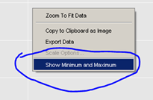

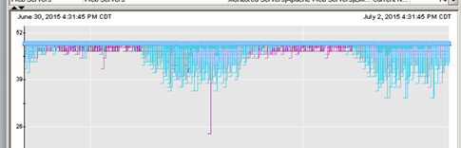
Investigate “Workers Depleted” message
Notes:
So we went to CA Wily (the monitoring tool responsible for the metric) and found the worker metrics. Busy workers, and idle workers. The average of both metrics were the same so we decided on idle workers (to be useful, busy workers would need to be compared to configured workers, a metric not in evidence. In contrast, minimum idle workers is compared to zero).
Idle workers showed us this chart. As this is a ‘negative metric’, meaning the busier you are, the lower on the chart the metric is. Which is to say, the busier you are, there are fewer idle workers available. As you can see it is a completely disinteresting chart. There is plenty of ‘head room’ (space under the line), so this could not possibly be the problem. This is the (was the) conventional wisdom, and none of the SMEs investigated this metric beyond this point. Instead, they went to other things, like network, database, load managers, sun spots, gremlins, etc..
===
What we did differently was to check the “Show Min, Max and Count” box, AND selected the “Show Minimum and Maximum” on the chart.
=
This is the exact same data with minimums shown. This gives a remarkably different impression. Much more volatile throughout the day. Much more information to compare to other metrics.
To read this chart you must realize that the busier you are, the closer to the bottom the lines get. When they reach zero, there are no more listeners to accept new connections, so you are in an outage state. Now there may be a small cache that gets serviced when workers become idle again, so very short episodes of zero idle workers can be recovered from gracefully. However, this depends on your application. Some will panic when there are no more listeners, even for a microsecond, and not respond well, or even crash.
With this understanding, we then took this technique and applied it to one of the devices that gave the ‘depleted listeners’ message.
==

Slide 32
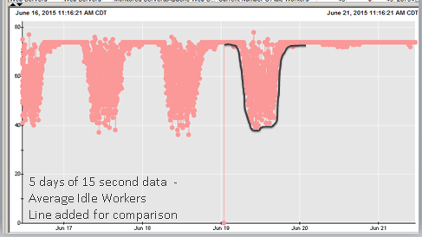
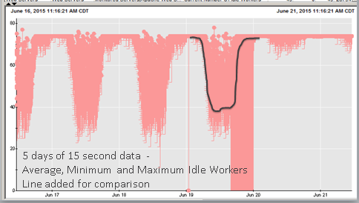
Average VS. Minimum
Got an alert and researched to see this Chart. Looks ‘fine’
Turned on min and saw this.
Much more interesting, and helpful.
This IS actionable intelligence.
Notes:
5 days of 15 second data Average Idle Workers
This device gave the message. But the top chart is not indicating that there is a problem. The chart is ONLY AVERAGE. And this is what was used to discount the messages. We see that we only use about half of the listeners available, and the system is ‘well behaved’.
HOWEVER,
===
The bottom chart is the same chart with Minimums. Now we have something quite festinating, we used fully ¾ of the available listeners. AND there is something different happening the latter half of June 19th.
Average showed nothing was wrong, but MINIMUM shows a significant event. This was cleared when the environment went through the midnight resets. Without this chart no one would know there was this problem, and the trouble that happened in the afternoon, which was not diagnosed, would have remained unsolved. The resolution was listed as ‘no fault found’.
So lets review what Average and Minimum are exactly.
Average is over the time slice. 50% average can be 50% for each observation over the entire time, OR 100% utilization for half of the observations, with 0% utilization for the other half. (or some combination of such)
Minimum is minimum at any point during the time slice. There is no way to know how long it lasted. Even this chart where the time slice is 15 seconds, the minimum could have only been one micro second, even thought it happens at least once per time slice.
So for very short periods, all idle workers were taken and released, such that the average of idle workers, over the hour, remained high. This happens in every 15 second slice for hours in the afternoon till midnight.

Slide 33
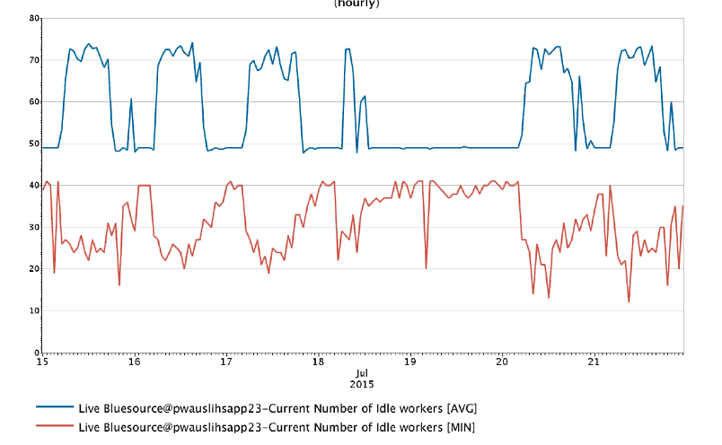
A Well Managed Device specific to Idle Workers
Notes:
This is a well managed device, specific to Idle Workers.
New workers are added automatically as the demand increases. Workers are returned as the demand decreases.
THIS is an excellent example of what we are striving for, as it pertains to average idle workers and minimum idle workers.

Slide 34
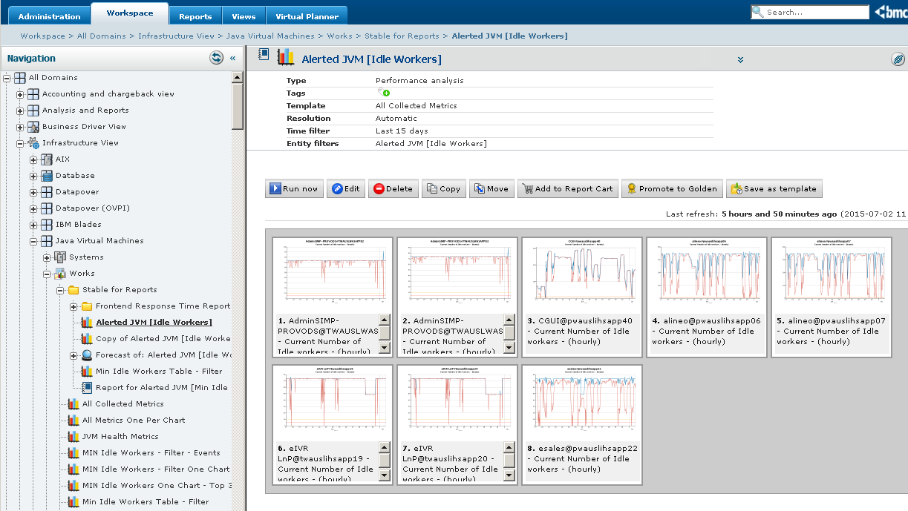
Alerted JVM (Idle Worker)
Notes:
We then took this metric and compared it to when these all hands on deck calls happened, and found a strong correlation. The write-ups had phrases like ‘cleared while testing’, ‘no fault found’ and ‘resolved without intervention’.
What this means is the idle workers goes to zero. People call in to complain. An all hands type call is started, and all sorts of things are checked. While the call is happening, the backlog clears and everything goes back to normal, and no one on the call has a clue why. It CAN’T BE (average) idle workers, that was checked and was fine, and everything else checked out. SO… it must be the network, or sun spots, or gremlins.
What the minimum idle workers metric allows, is for the investigation to focus on why the workers are being eaten at a faster rate, being kept open longer than normal, or not releasing back to idle as quickly as they normally do. Sometimes you find that you just don’t have enough configured listeners in the first place. Regardless of the reason, with the minimum idle workers going to zero metric, you can focus on where the issue is, and ignore where it is not (read it is not the network). Your customers are happy, and the gremlins are left to their sun spots.
The worst failure mode is the connections that had no idle workers remain in a ‘hung state’ even when idle workers become available. This gives a user or three, a persistent failure, when everyone else is working correctly. In cases like these, users are told to reboot, which ‘fixes’ the problem. The cause is written off as ‘user trouble’ when in fact, it was the application not responding well to a zero idle worker condition.
Value statement – Using minimum idle workers, one of the applications changed its configuration, and went from having three or four all hands on deck calls a week, to not a single one for the year after the change.

Slide 35
Summarize What We Did
Looked for ‘No fault found’ and
‘Cleared while testing’ type phrases.
Created a report with the minimum or maximum for the metric (idle workers)
Analyze to understand what the metric responds to
Made an exception report in TSCO
Created a report based on the devices that triggered the exception
Became (more) awesome, by finding actionable intelligence
Separate how we did it from the value we got from it.
Notes:
To summarize what we did, and more to the point what you can do as well…
Look for ‘cleared while testing’ type phrases and review the relevant device metrics with minimum, average and maximum values.
Analyze to understand what the metric actually means and what it responds to. Then make recommendation based on this new understanding and which metrics give indications of the problem condition.
Make an exception report in TSCO. There is a hidden slide to show how we did that.
Create a report based on the devices and metrics that triggered the exception.
Then become even more awesome by finding actionable intelligence in ‘well understood’ metrics.
Value Statement – Using these tools and techniques, TSCO enables the reevaluation of known metrics, such that new actionable intelligence is found. This also resulted in a vast improvement in the stability of an important application.

Slide 36
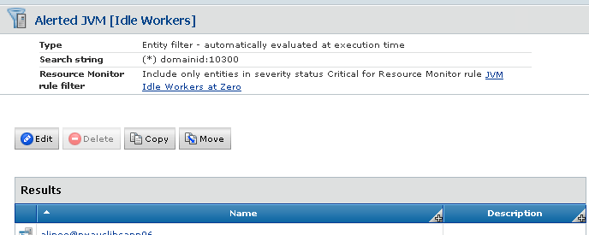
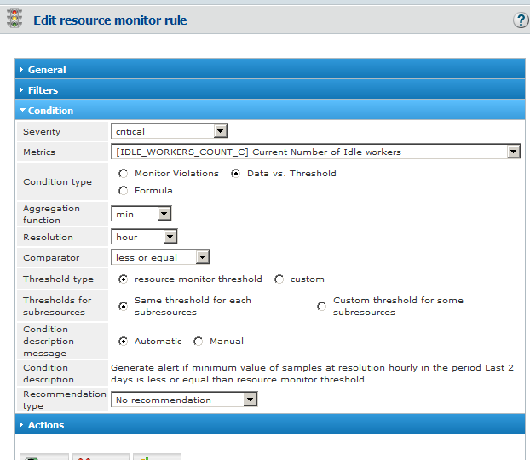
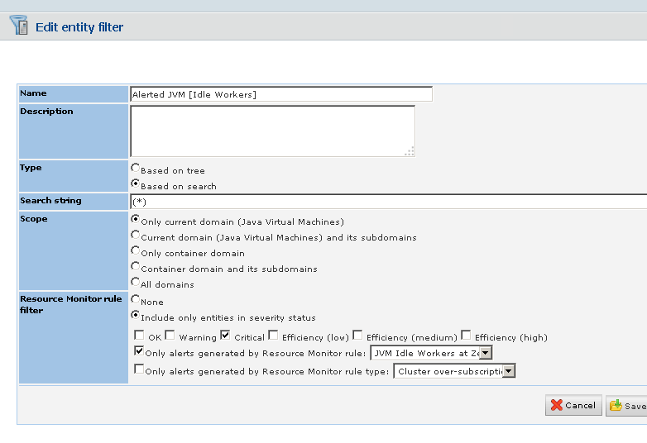
Notes:
To create this report…
Make a
This report shows the last 30 day history for devices that have shown zero idle workers in the last two days.
The minimum idle workers metric is reviewed, specifically on the JVMs that go to or get close to zero idle workers.
To be clear, the configuration setting of MaxClients on a web service, defines what can be thought of as 'available workers'. Each worker can be in one of two states: Busy Worker or Idle Worker. Each reporting time slice has three relevant metrics, the maximum busy worker, the average busy (or idle) workers, and minimum idle workers. The maximum busy workers plus the minimum idle workers will add up to available workers. The average busy (or idle) worker can be anywhere between those two values.
When minimum idle workers gets to zero, the web service can no longer service new requests, regardless of reserve bandwidth, CPU availability, RAM availability or any other resource. Any new requests are placed in a queue or rejected, depending on the application. When the idle workers are depleted and the queue builds, the response time elongates from the end users point of view. This backlog may be resolved relatively quickly and not noticed by the user. However, when this happens for extended periods users may notice. When idle workers are depleted and new connections rejected, the application my present the user with an error message, or default to an alternate mode. eIVR is an example where any error redirects the user to a much more reliably (and expensive) inquiry handling system.
How the application handles the zero idle workers condition, determines how loosely or closely this setting should be maintained. SMEs should evaluate this metric as it relates to their area, and determine what an appropriate setting is for MaxClients, Specifically: Determine what happens to the application when minimum idle workers reaches zero. Determine what depletes idle workers and keeps them in use. Determine what an adequate buffer is. Each configured available worker consumes CPU, and memory, and may consume other resources as well. These factors together, will indicate an appropriate MaxClient setting.
To be clear the minimum idle worker metric can be an indication of an issue elsewhere. A surge in connections, connections that last longer than normal, connections that do not disconnect as expected, delays processing the request can keep connections open, and a host of other issues. So investigate these causes first. When these things are behaving normally, and you still find yourself short of minimum idle workers, the proper response may be to increase the MaxClients setting, effectively making more available workers.

Slide 37
A Call To Action / Questions
Tools and Techniques in these contexts
-Analysis of diverse data
-Chargeback to projects
- IT Cost VS. IT Charges
- Open ‘to the masses’
- The Power of Views
- Over Used, add resources
- Under Used, remove resources
A ‘Well Understood’ metric, JVM Idle Workers
Submit your card with: Presentation, chargeback, or training on the back
Notes:
In closing,
You should have gotten the message that:
TSCO can do interesting value add work, but it takes effort and commitment. If you put data into TSCO you can analyze diverse data. Then it is a short leap to chargeback and costing. Then you find that because the data is available, others can easily get value out of the data, which you can enable by opening it to the masses, and making views. Views can take the same data and show over used resources, then the same data sorted differently can show under used resources.
Additionally, you should be excited that the ‘traditional’ metric of average can be expanded to extract additional value by exploring other metrics, specifically minimum and maximum.
Leave your card with requests on the back..
Submit your card with: Presentation, chargeback, or training, on the back
We will forward you any of the documents we discuss here, but they are big. So only request what you will use.

Slide 38
A Call To Action / Questions
What YOU should do, starting now:
Make Actionable Intelligence
Get data into TSCO, and use it.
Review ‘well understood’ metrics, Use Min and Max
‘No fault found’, is a road sign to investigate for actionable intelligence
Submit your card with: Presentation, chargeback, or training, on the back
Notes:
So our call to action is:
First, and starting right now, make actionable intelligence
Put forth the effort to get data in TSCO, then put forth the effort to extract actionable intelligence from that data. Pay attention to metrics other than average.
When you see ‘cleared while testing’, ‘no fault found’ and ‘cleared without intervention’ go find the queue, cache, or process that ran out of resource. To do that, be hyper sensitive to ‘unrelated’ alerts, messages and logs. Then look at minimum and maximum as well as average for the devices involved.
Value Add of TSCO is: that once a metric like this this is found, TSCO can report on that metric and alert when the threshold is violated. This, in our case, has greatly improved reliability. TSCO can do this for you as well.

Slide 39

A Call To Action / Questions
‘No Fault Found’…
There is actionable intelligence here.
Submit your card with: Presentation, chargeback, or training, on the back
Notes:
To help you remember that ‘no fault found’, ‘cleared while testing’, and ‘cleared without intervention’ are road signs suggesting something is ‘not right’, think of this presentation, or if this helps, think of me. With these sorts of indicators you should think to yourself… There is actionable intelligence here.

Slide 40





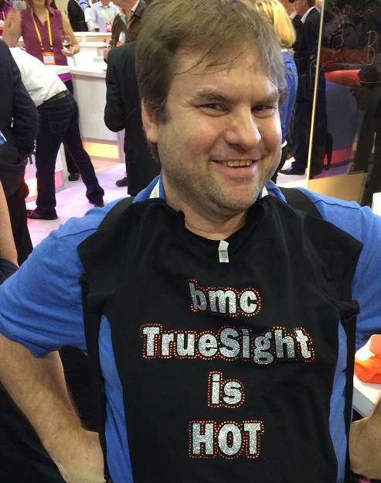
James Kistler
Infrastructure Planning Service Manager
312.653.4848
james_kistler@hcsc.net
www.hcsc.com
Thank You.
Ben Davies
Sr. IT Business Consultant
918.814.6588
ben_davies@hcsc.net
www.hcsc.com
Submit your card with: Presentation, chargeback, or training, on the back
Notes:
Thank you for your time and attention.
Feel free to talk to either of us, at the conference, or by phone or email.
Leave your card with requests for information: Presentation, chargeback, or training, on the back.

